Slide 1

EXPOSYS DATA LAB
FULL STACK DEVELOPER INTERNSHIP 2023-2024

Slide 2
TABLE OF CONTENTS
01
Abstract
02
Introduction
03
Existing Method
04
Proposed Method
05
Implementation
06
Conclusion

Slide 3
01
ABSTRACT

Slide 4
“Brrrgrr” – Online website which sells Burger
A dedicated online platform for burger enthusiasts brings exceptional benefits, offering a diverse menu of burgers with a unique feature for personalized customization. Users can tailor their burgers, choosing the bun type, specifying size, and selecting specific ingredients, including extras of their choice. The platform provides real-time cost updates, ensuring a convenient and user-friendly experience for ordering burgers that cater to individual tastes.

Slide 5
Blog Application
An innovative online application empowers users to perform CRUD operations on posts. To access the platform, individuals register by providing essential details. After registration, users can log in and create personalized posts. The website facilitates the creation of a Word document based on a predefined template. Essentially, the platform serves as a dynamic space for registered users to seamlessly translate their blog posts into structured Word documents, enhancing the overall content creation experience.

Slide 6
02
INTRODUCTION

Slide 7
“Brrrgrr” – Online website which sells Burger
The project aims to create an interactive online burger customization platform for enthusiasts. This user-friendly platform offers a variety of pre-designed options, allowing users to tailor their burgers by choosing bun types, sizes, and specific ingredients. Real-time cost display, visual interfaces, and interactive features enhance the ordering experience. Event Listeners and a virtual chalkboard further streamline the process, ensuring transparency in pricing based on ingredient costs and empowering customers to make informed decisions.

Slide 8
Blog Application
The platform enables users to effortlessly create and manage personalized posts aligned with their interests. Registration is straightforward, providing users access to various features. Once registered, users can log in to craft posts tailored to their preferences. What distinguishes this platform is its unique feature—automatic generation of a Word document. This enhances the user experience by seamlessly translating content into organized documents. Serving as a dynamic hub, the platform encourages active content creation and ensures a smooth transition from idea to polished documents.

Slide 9
03
EXISTING METHOD

Slide 10
“Brrrgrr” – Online website which sells Burger
In the existing system, individuals are required to physically visit the burger shop to place manual orders. The ordering process is limited to selecting from the pre-existing menu list, providing little room for customization based on personal taste and preferences. This approach offers minimal visual engagement for the user, as the options are static and do not allow for the dynamic and interactive experience that could enhance their overall satisfaction.
Blog Application
In the current system, individuals often turn to traditional blogging platforms that lack a cohesive and personalized approach to managing blogs, resulting in various challenges. Users experience a fragmented journey, navigating through different interfaces for tasks like creating, reading, editing, and deleting blog posts, leading to inefficiency. The absence of a centralized dashboard complicates effective blog management, making the process time-consuming. Navigating through different functionalities may not be user-friendly, particularly for new bloggers seeking a streamlined experience.

Slide 11
04
PROPOSED METHOD

Slide 12
“Brrrgrr” – Online website which sells Burger
The proposed system offers a dynamic and user-friendly web application that allows users to personalize their burgers according to their preferences. This system aims to address the limitations of the existing static and unconventional methods by leveraging modern web technologies. By providing a wide variety of burger ingredients, aided by attractive visuals, this system enhances the overall visual experience for the users.
Blog Application
The proposed system addresses the drawbacks of the current system by offering an online platform that allows users to independently create blog posts according to their interests, without the need for any intervention from other individuals. The other feature available are user friendly navigation, Efficiently blog creation, Structured Reading section.

Slide 13
05
IMPLEMENTATION

Slide 14
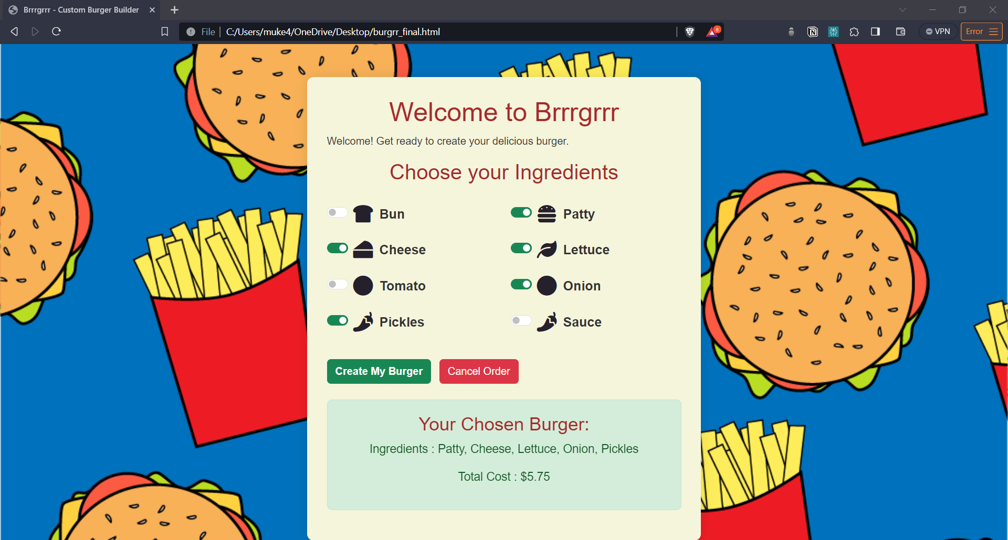
Brrrgrr

Slide 15
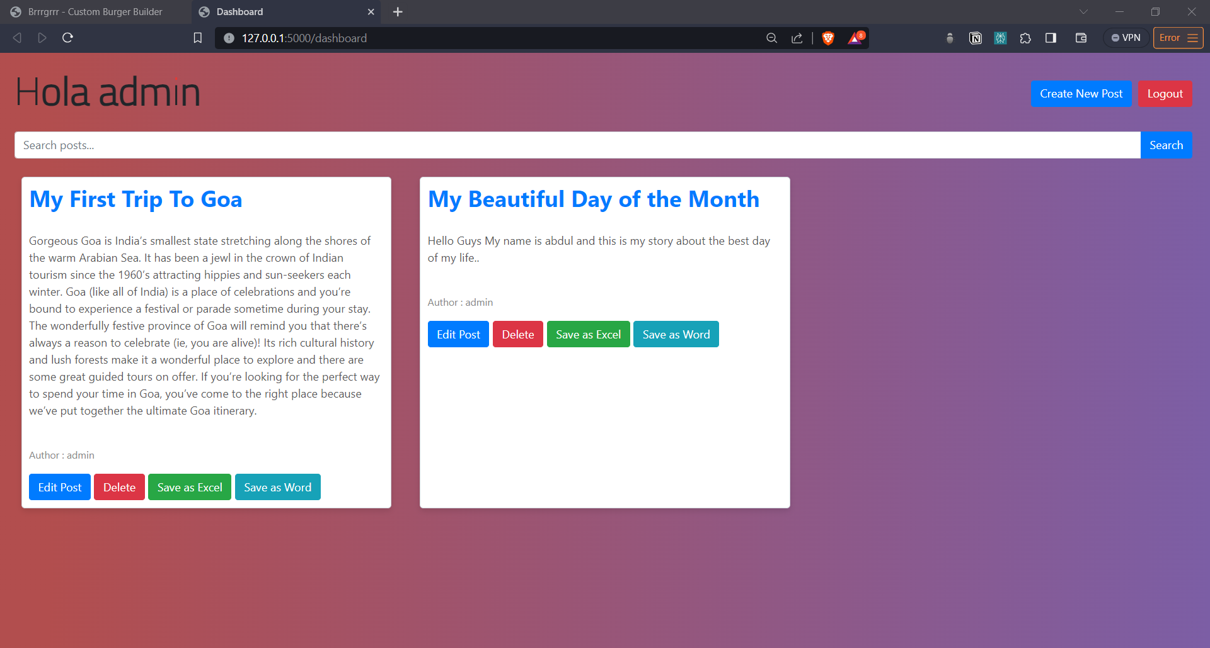
Blog Application

Slide 16
06
CONCLUSION

Slide 17
“Brrrgrr” – Online website which sells Burger
In conclusion, Brrrgrrr is an online platform that allows burger enthusiasts to fully customize their orders, providing a visually appealing interface and real-time adjustments. It offers a valuable and user-friendly experience, empowering users to tailor their burgers precisely to their tastes.
Blog Application
In Conclusion, the Blog Application provides a user-friendly platform for seamless blog creation, management, and CRUD operations. Addressing challenges in traditional platforms, it introduces a centralized dashboard and automatic generation of structured Word documents, enhancing user autonomy and efficiency in blog management.

